Slide 1
Machine Learning Impact on Retail Life
CBC-I Retail Life CoE

Slide 2
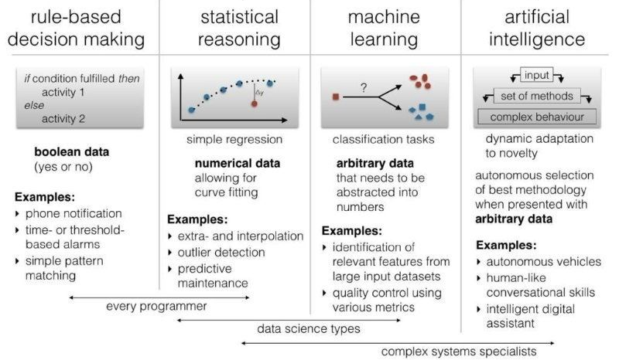
The Evolution of Machine Learning

Slide 3
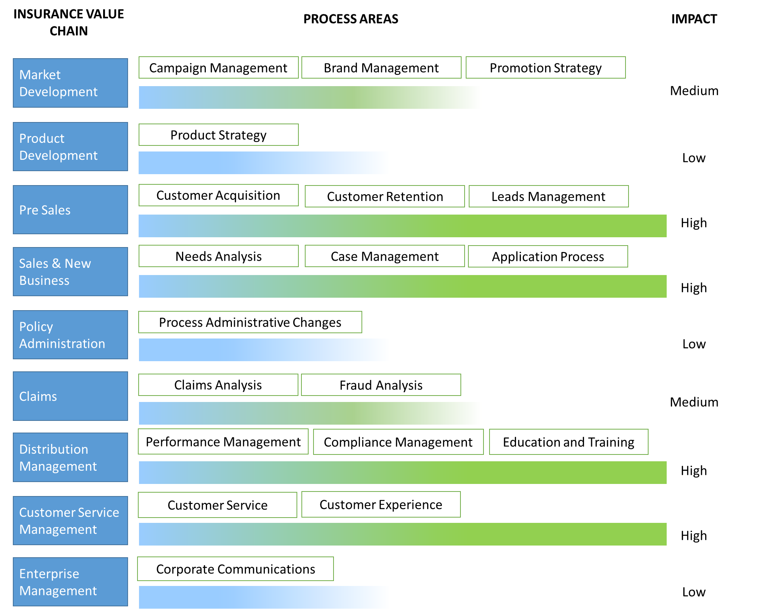
NLP impact across the Insurance Value Chain
LOW IMPACT
Has minimal impact but can help achieve optimization upon current business processes.
MEDIUM IMPACT
Ability to augment existing process capabilities and improve efficiency.
HIGH IMPACT
Has potential to radically change operating model and achieve dramatic improvements in productivity.
Medium
High

Slide 4
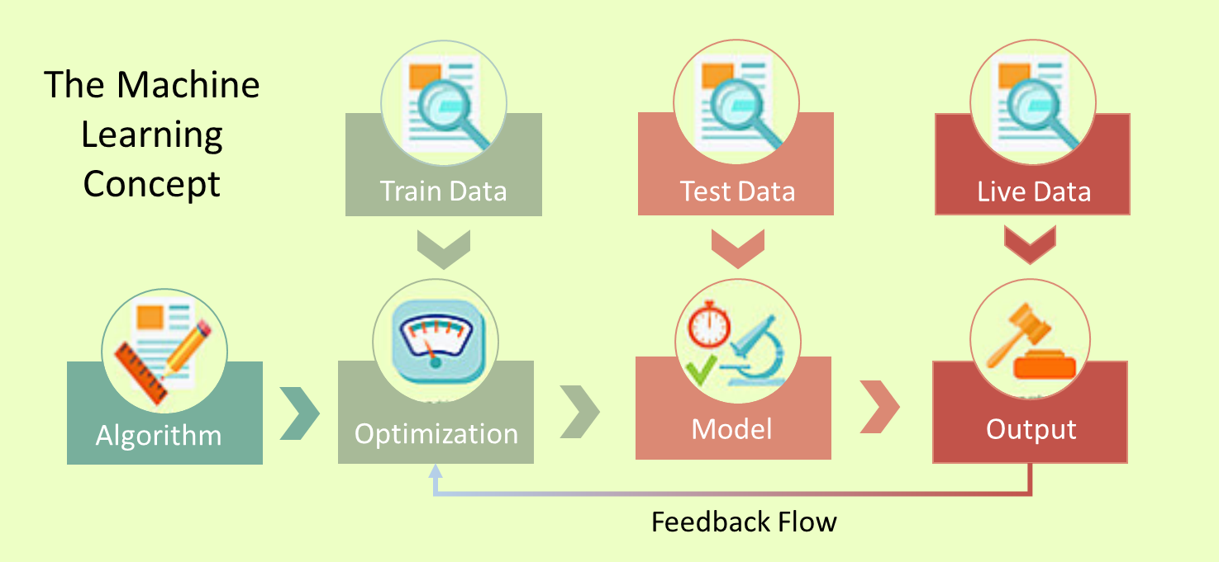
Proof of Concept at NM
Data Sources
E-Mail Supervision System
Archived- Communications
Recent Quarter Communications
Real-time Communications
Compliance System
Past Reports
Cross- Validating Algorithm
Enterprise Machine Learning Platform
Natural Language Processing Algorithm
Reporting
Visualization Tool

Slide 5
Thank You

Slide 6
Appendix

Slide 7
Access to Business Insights
COMMUNICATION DATASET
EXCEPTION CATEGORY
PROBABILITY
Complaints
0.02%
Supervisory and Regulatory Actions
0.03%
33 E-Mails
NATURAL LANGUAGE PROCESSING ALGORITHM
45 Skype Scripts
Replacements
0.3%
15 Yammer Scripts
Surrenders
3.43%
Free Looks
72.37%
Withdrawals
0.02%

